Slide 1
Rational Equations and Functions
Algebra II
Chapter 8
Notes:
Algebra II 8

Slide 2
This Slideshow was developed to accompany the textbook
  Larson Algebra 2
  By Larson, R., Boswell, L., Kanold, T. D., & Stiff, L.
  2011 Holt McDougal
Some examples and diagrams are taken from the textbook.
Slides created by
Richard Wright, Andrews Academy
rwright@andrews.edu

Slide 3
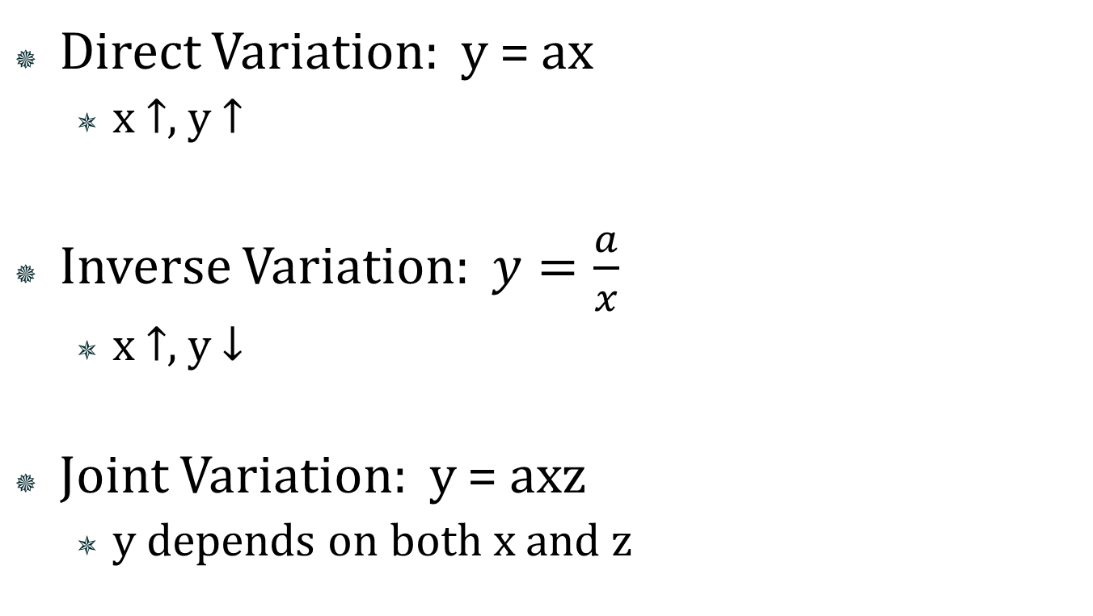
8.1 Model Inverse and Joint Variation
Direct Variation: y = ax
  x ↑, y ↑
Inverse Variation: $y=\frac{a}{x}$
  x ↑, y ↓
Joint Variation: y = axz
  y depends on both x and z
a
is the constant of variation

Slide 4
8.1 Model Inverse and Joint Variation
What type of variation is each of the following?
  xy = 48
  2y = x
  y = 2x + 3
Notes:
y = 48 / x → inverse
y = ½ x → direct
+3 means neither

Slide 5
8.1 Model Inverse and Joint Variation
Solving Variations
  Plug in x and y to find a
  Plug in a and the other value and solve
y varies inversely as x. When x = 2, y = 6. Write an equation relating x and y. Then find y when x = 4.
Notes:
y = k/x → 6 = k/2 → 12 = k
y = 12 / 4 → y = 3

Slide 6
8.1 Model Inverse and Joint Variation
Checking data for variation
  Plug each of the data points in one of the variation equations to find a
  If the a stays the same, the data has that type of variation
What type of variation?
X | 2 | 4 | 8
y | 8 | 4 | 2

Slide 7
8.1 Model Inverse and Joint Variation
Writing variations from sentences
  y varies directly with x and inversely with z²
  z varies jointly with x² and y
  y varies inversely with x and z
Notes:
Varies means “=a”
y = ax/z²
z = ax²y
y = axz

Slide 8
Quiz
8.1 Homework Quiz

Slide 9
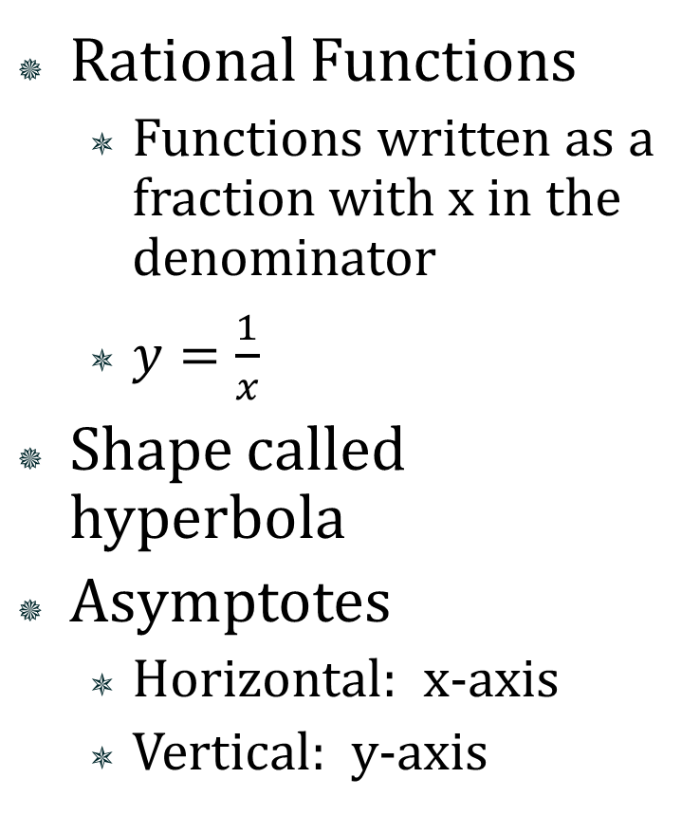
8.2 Graph Simple Rational Functions
Rational Functions
  Functions written as a fraction with x in the denominator
  $y=\frac{1}{x}$
Shape called hyperbola
Asymptotes
  Horizontal: x-axis
  Vertical: y-axis

Slide 10
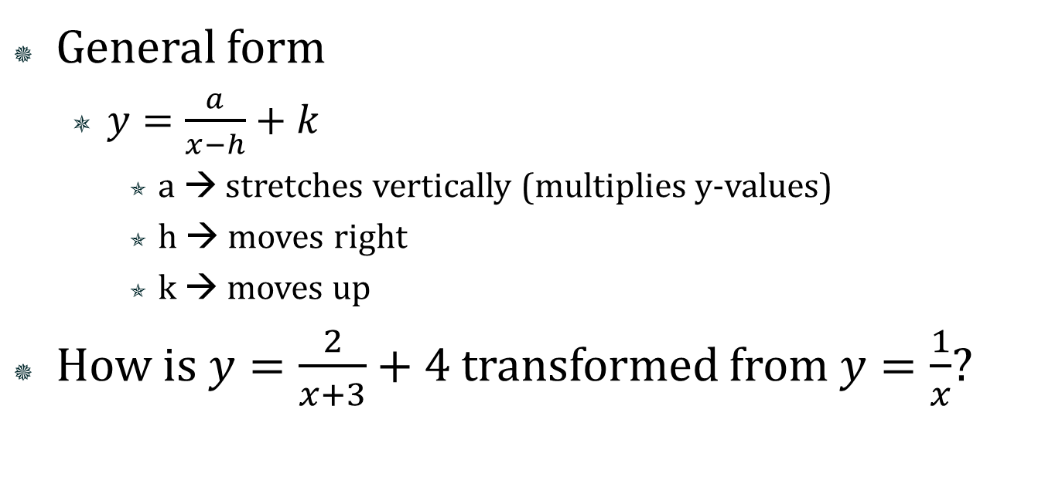
8.2 Graph Simple Rational Functions
General form
  $y=\frac{a}{x−h}+k$
    a → stretches vertically (multiplies y-values)
    h → moves right
    k → moves up
How i$s y=\frac{2}{x+3}+4$ transformed from $y=\frac{1}{x}$?
Notes:
Stretches vertically by factor of 2
Moves left 3
Moves up 4

Slide 11
8.2 Graph Simple Rational Functions
How to find asymptotes
  Vertical
    Make the denominator = 0 and solve for x
Notes:
Vertical: 3x – 6 = 0 → 3x = 6 → x = 2
Horizontal: y = (2*1000000)/(3*1000000 – 6) → y = 2/3

Slide 12
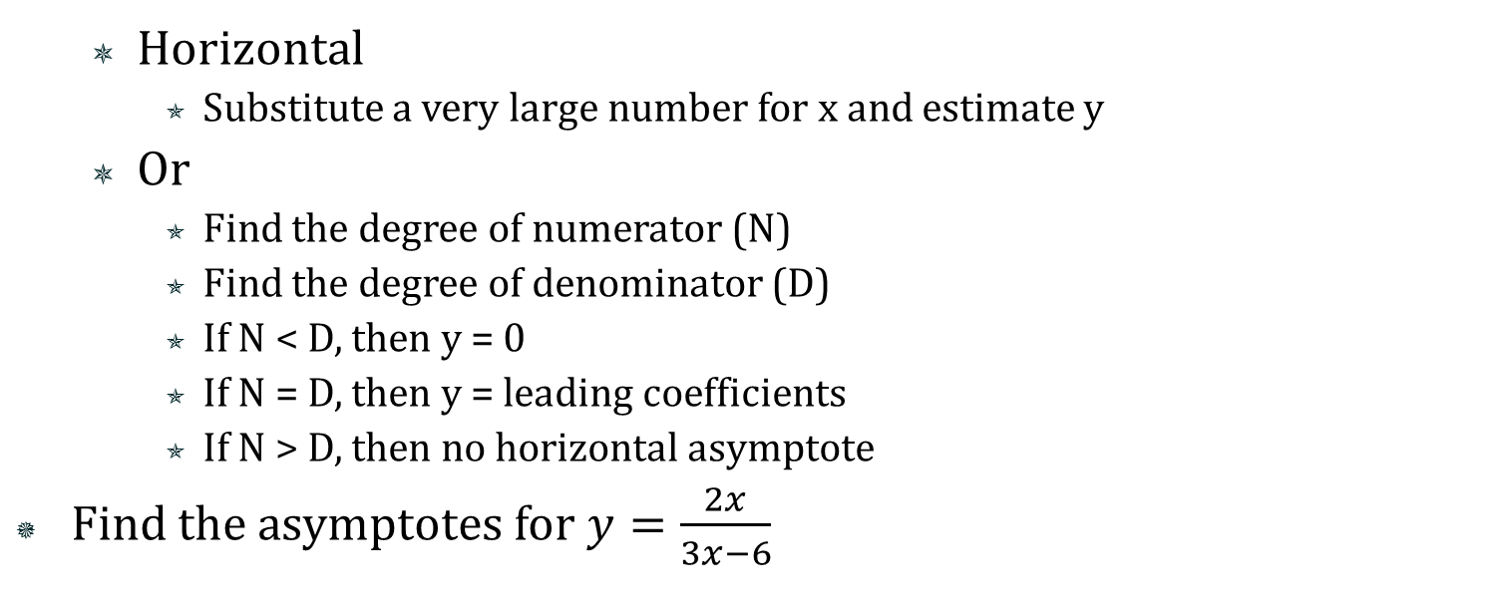
8.2 Graph Simple Rational Functions
  Horizontal
    Substitute a very large number for x and estimate y
  Or
    Find the degree of numerator (N)
    Find the degree of denominator (D)
    If N < D, then y = 0
    If N = D, then y = leading coefficients
    If N > D, then no horizontal asymptote
Find the asymptotes for $y=\frac{2x}{3x−6}$

Slide 13
8.2 Graph Simple Rational Functions
Domain
  All x’s except for the vertical asymptotes
Range
  All the y’s covered in the graph
  Usually all y’s except for horizontal asymptote

Slide 14

8.2 Graph Simple Rational Functions
Graph by finding asymptotes and making a table
Graph $y=\frac{2}{x+3}+4$
Notes:
Asymptotes
Vertical: x + 3 = 0 → x = -3
Horizontal: y = 2/(1000000 + 3) + 4→ y = 4

Slide 15
Quiz
8.2 Homework Quiz

Slide 16
8.3 Graph General Rational Functions
Find the asymptotes
  Simplify first
    Factor and cancel entire factors
  Vertical
    take the denominator = 0 and solve for x
Notes:
Vertical: x² – 1 = 0 → x² = 1 → x = ±1
Horizontal: y = (2(1000000)² + 1000000)/(1000000² -1) → y = 2

Slide 17
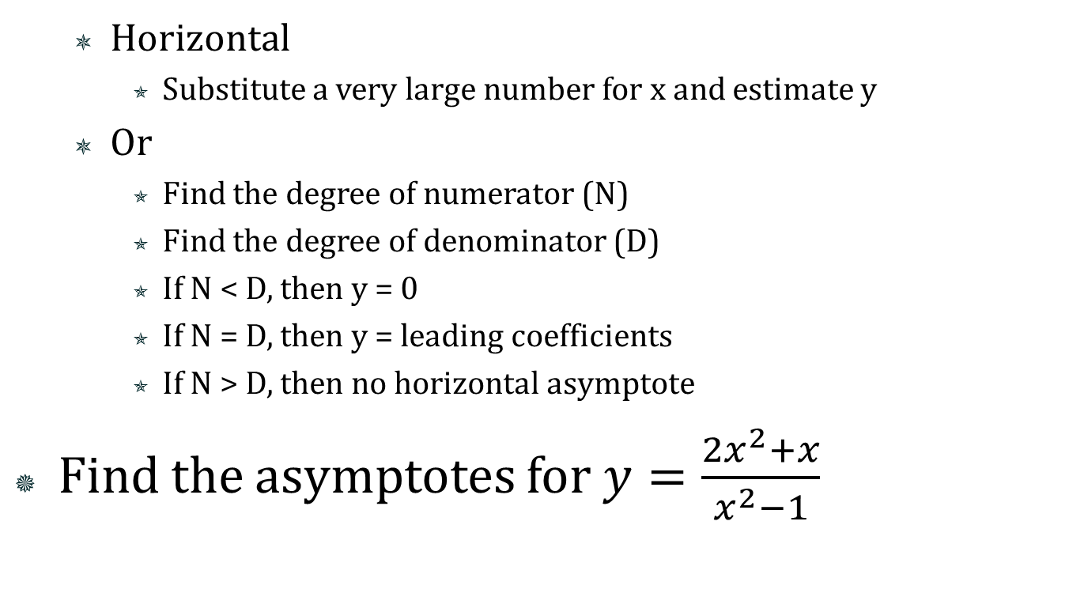
8.3 Graph General Rational Functions
  Horizontal
    Substitute a very large number for x and estimate y
  Or
    Find the degree of numerator (N)
    Find the degree of denominator (D)
    If N < D, then y = 0
    If N = D, then y = leading coefficients
    If N > D, then no horizontal asymptote
Find the asymptotes for $y=\frac{2x^{2}+x}{x^{2}−1}$

Slide 18
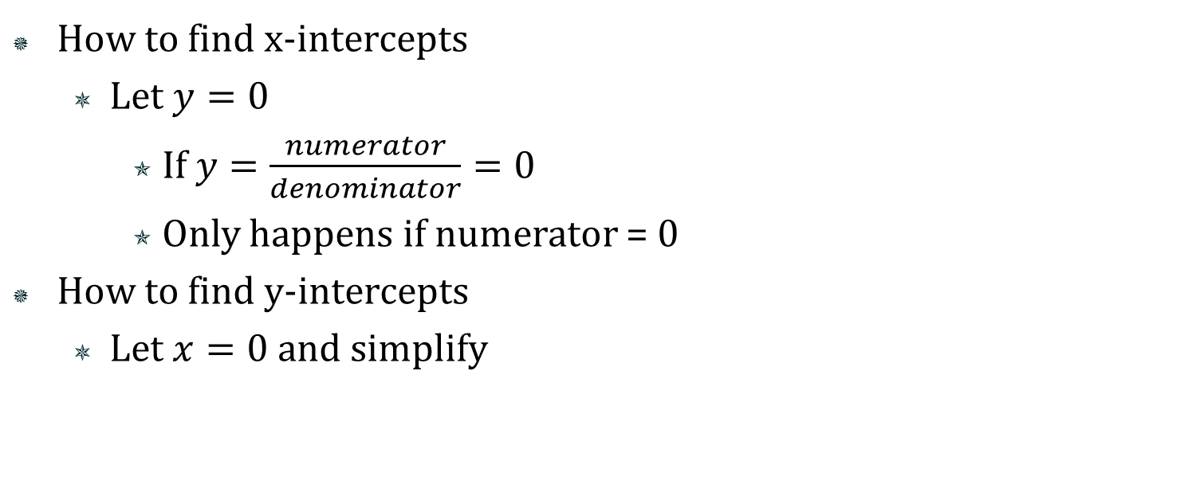
8.3 Graph General Rational Functions
How to find x-intercepts
  Let $y=0$
    If $y=\frac{numerator}{denominator}=0$
    Only happens if numerator = 0
How to find y-intercepts
  Let $x=0$ and simplify

Slide 19
8.3 Graph General Rational Functions
To graph rational functions
  Find the asymptotes
  Make a table of values around the vertical asymptotes
  Graph the asymptotes and points
  Start near an asymptote, go through the points and end near another asymptote
    Each graph will have several sections
    NEVER cross a vertical asymptote

Slide 20

8.3 Graph General Rational Functions
Graph $y=\frac{2x^{2}+x}{x^{2}−1}$
Notes:
Vertical: x² – 1 = 0 → x² = 1 → x = ±1
Horizontal: y = (2(1000000)² + 1000000)/(1000000² -1) → y = 2

Slide 21
Quiz
8.3 Homework Quiz

Slide 22
8.4 Multiply and Divide Rational Expressions
Simplified form → numerator and denominator can have no common factors
Steps to simplify
  Factor numerator and denominator
  Cancel any common factors

Slide 23


8.4 Multiply and Divide Rational Expressions
Simplify
$\frac{x^{2}−5x−6}{x^{2}−1}$
$\frac{x^{3}+5x^{2}+6x}{x^{3}+2x^{2}}$
Notes:
((x-6)(x+1))/((x-1)(x+1)) → (x-6)/(x-1)
(x(x+3)(x+2))/(x²(x+2)) → (x+3)/x

Slide 24
8.4 Multiply and Divide Rational Expressions
Multiplying Rational Expressions
  Factor numerators and denominators
  Multiply across top and bottom
  Cancel factors

Slide 25


8.4 Multiply and Divide Rational Expressions
$\frac{3x−27x^{3}}{3x^{2}−2x−1}⋅\frac{3x^{2}−4x+1}{3x}$
$\frac{x+2}{27x^{3}+8}⋅(9x^{2}−6x+4)$
Notes:
(-3x(9x²-1))/((3x+1)(x-1)) * ((3x-1)(x-1)) → (-3x(3x-1)(3x+1)(3x-1)(x-1))/(3x(3x+1)(x-1)) → -(3x-1)²
(x+2)/((3x+2)(9x²-6x+4)) * (9x²-6x+4)/1 → (x+2)/(3x+2)

Slide 26
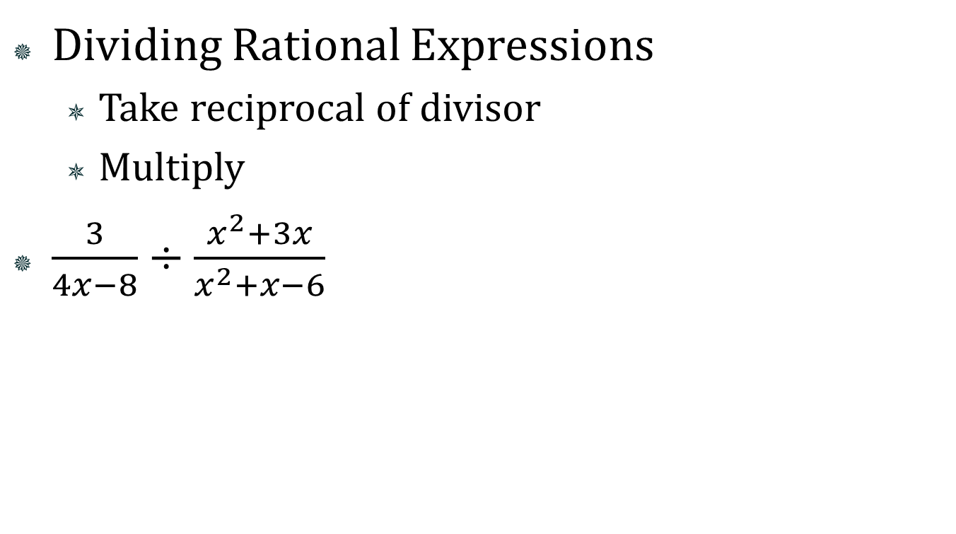
8.4 Multiply and Divide Rational Expressions
Dividing Rational Expressions
  Take reciprocal of divisor
  Multiply
$\frac{3}{4x−8}÷\frac{x^{2}+3x}{x^{2}+x−6}$
Notes:
3/(4x-8) * (x²+x-6)/(x²+3x) → 3/(4(x-2)) * ((x-2)(x+3))/(x(x+3)) → 3/(4x)

Slide 27
8.4 Multiply and Divide Rational Expressions
Combined Operations
  Do the first two operations
  Use that result with the next operation

Slide 28
Quiz
8.4 Homework Quiz

Slide 29
8.5 Add and Subtract Rational Expressions
Adding and Subtracting
  Need least common denominator (LCD)
    If LCD already present, add or subtract numerators only
  To get fractions with LCD
    Factor all denominators
    LCD is the common factors times the unique factors
    Whatever you multiply the denominator by, multiply the numerator also

Slide 30


8.5 Add and Subtract Rational Expressions
$\frac{3}{2x}−\frac{7}{2x}$
$\frac{3x}{x−4}+\frac{6}{x−4}$
Notes:
-4/(2x) → -2/x
(3x+6)/(x-4)

Slide 31


8.5 Add and Subtract Rational Expressions
$\frac{4}{3x^{2}}+\frac{x}{6x^{3}+3x^{2}}$
$\frac{x+1}{x^{2}+6x+9}−\frac{1}{x^{2}−9}$
Notes:
$$\frac{4}{3x^{2}}+\frac{x}{3x^{2}\left(2x+1\right)}→\frac{4\left(2x+1\right)}{3x^{2}\left(2x+1\right)}+\frac{x}{3x2\left(2x+1\right)}→\frac{9x+4}{3x2\left(2x+1\right)}$$
$$\frac{x+1}{\left(x+3\right)\left(x+3\right)}–\frac{1}{\left(x+3\right)\left(x−3\right)}→\frac{\left(x+1\right)\left(x−3\right)}{\left(x+3\right)2\left(x−3\right)}−\frac{x+3}{\left(x+3\right)2\left(x−3\right)}→\frac{x2 – 2x – 3}{\left(x+3\right)2\left(x−3\right)}–\frac{x + 3}{\left(x+3\right)2\left(x−3\right)}→\frac{x2 −3x−6}{\left(x+3\right)2\left(x−3\right)}$$

Slide 32
8.5 Add and Subtract Rational Expressions
Simplifying Complex Fractions
  Fractions within fractions
  Follow order of operations (groups first)
  Divide

Slide 33

8.5 Add and Subtract Rational Expressions
$\frac{\frac{3}{x−4}}{\frac{1}{x−4}+\frac{3}{x+1}}$
Notes:
$$\frac{\frac{3}{x−4}}{\frac{1}{x−4}+\frac{3}{x+1}}→\frac{\frac{3}{x−4}}{\frac{1\left(x+1\right)}{\left(x−4\right)\left(x+1\right)}+\frac{3\left(x−4\right)}{\left(x−4\right)\left(x+1\right)}}→\frac{\frac{3}{x−4}}{\frac{x+1}{\left(x−4\right)\left(x+1\right)}+\frac{3x−12}{\left(x−4\right)\left(x+1\right)}}→\frac{\frac{3}{x−4}}{\frac{4x−11}{\left(x−4\right)\left(x+1\right)}}→\frac{3}{x−4}⋅\frac{\left(x−4\right)\left(x+1\right)}{4x−11}→\frac{3\left(x+1\right)}{4x−11}$$

Slide 34
Quiz
8.5 Homework Quiz

Slide 35
8.6 Solve Rational Equations
Only when the = sign is present!!!
Method 1: simplify both sides and cross multiply
Method 2:
Multiply both sides by LCD to remove fractions
Solve
Check answers

Slide 36


8.6 Solve Rational Equations
$\frac{3}{x}−\frac{1}{2}=\frac{12}{x}$
$\frac{5x}{x+1}=4−\frac{5}{x+1}$
Notes:
(3(2x))/x – 2x/2 = (12(2x))/x → 6 – x = 24 → -x = 18 → x = -18
5x = 4(x+1) – 5 → 5x = 4x + 4 – 5 → x = -1
Check answer: can’t divide by -1 so NO SOLUTION

Slide 37


8.6 Solve Rational Equations
$\frac{3x−2}{x−2}=\frac{6}{x^{2}−4}+1$
$\frac{3}{x^{2}+4x}=\frac{1}{x+4}$
Notes:
(3x-2)/(x-2) = 6/((x-2)(x+2)) + 1 → (3x-2)(x+2) = 6 + (x-2)(x+2) → 3x² + 4x – 4 = 6 + x² – 4 → 2x² + 4x – 6 = 0 → x² + 2x – 3 = 0 → (x – 1)(x + 3) = 0 → x = 1, -3
3/(x(x+4)) = 1/(x+4) → 3 = x

Slide 38
Quiz
8.6 Homework Quiz

